Slide 1


Accelerating Rooftop Solar In Assam
June 20, 2025

Slide 2
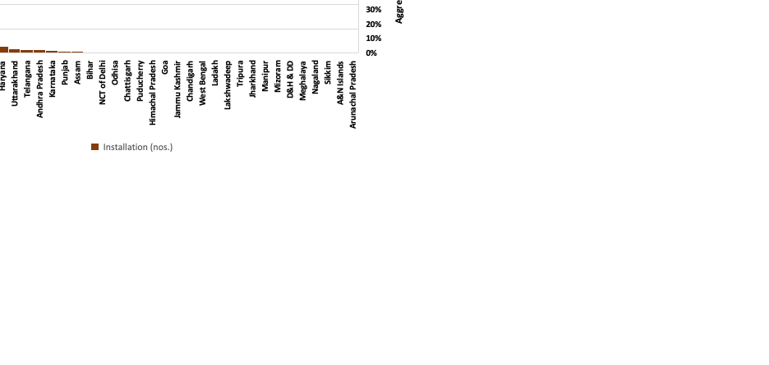
Rooftop Solar: Key to Land-Neutral RE Growth in India
Growth of RTS capacity in India (2019–2025)
17.7 GW RTS installed by March 2025; 47.7% CAGR since 2019.
Gujarat & Maharashtra lead with ~50% of total capacity; Kerala & UP witnessing rapid growth.
Residential & government uptake rising under PM-Surya Ghar Yojana through streamlined subsidies and strong targets.
~7 GW in C&I segment driven by a maturing market and better financing access.
RTS now forms 10% of India’s non-hydro RE capacity.
Number of RTS installations state-wise under PM-SGY
Source: MNRE

Slide 3
Best Practices in RTS Adoption by Leading States
State-level branding for RTS scheme
Enhanced utility capacity and capability
Dedicated & structured effort at consumer awareness
Streamlining/expediting approval processes (net metering, subsidy dispersal)
Digitalisation of the entire value chain infrastructure
Building EPC/vendor base
Ensuring availability of bi-directional meters & other equipment
Ensuring availability of financing options
Ensuring high quality of installations
Ensuring robust after-sales service

Slide 4
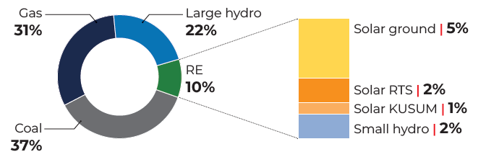
Assam’s RTS Journey
Assam’s energy mix is dominated by coal and gas, with RE at just 10%; As of March 2025, installed solar capacity ~225 MW, with RTS ~53 MW.
Policy & Regulatory Push:
  AREP 2022 target of 300 MW RTS by 2027 vs ICEP 2025 target: 1,900 MW RTS by 2030
  State financial assistance: ₹15,000/kW (max ₹45,000), in addition to CFA
  Regulatory enablers: Group/virtual net metering, inspection waiver for systems <500 kVA
Installed capacity mix of Assam (April 2025)
Source: MNRE

Slide 5
Growth & Projections
Strong uptake under PM-Surya Ghar Yojana + state subsidies - Assam ranks 4th nationally with ~2.7 lakh PM-SGY applications in 9 months
RTS growth: ~15% CAGR over 5 years; recent surge at ~2% monthly | 400+ EPCs empanelled; more being added.
Need for enhanced effort for RTS promotion, given the challenges involved in setting up ground-mounted PV projects and the significant benefits of rooftop solar in Assam—including land neutrality, grid support, cost savings, improved energy access, and contribution to climate and development goals.
At present, under BAU, the RTS capacity is expected to reach 88 MW by 2027 and 356 MW by 2030.
Growth of solar energy in Assam (2014–2025)
Target vs current growth in RTS
Source: MNRE
Source: iFOREST analysis

Slide 6

Focus/Objective
Comprehensive assessment of Assam’s RTS potential, focusing on spatial distribution, technical feasibility, regulatory support, market dynamics, and implementation challenges.
Aims to inform decision-makers, utilities, and industry stakeholders by providing a data-driven view of where and how RTS can be effectively scaled across the state.
Provides recommendations for way forward for solar adoption, based on mapping of market dynamics.

Slide 7
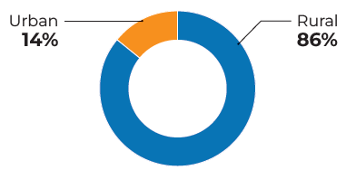
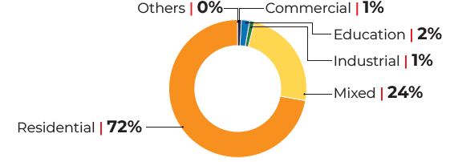
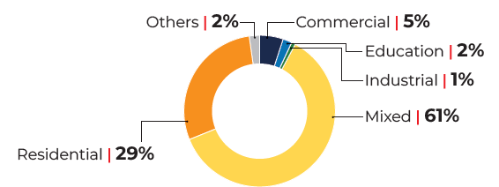
Estimating Total Rooftop Area of Assam
Built-up footprint area (BFA) estimated at 737.1 km², using GIS-based modelling. Including 53% flat roofs (390.6 sq km), and 47% sloped (346.4 km²).
BFA rural and urban area-wise
Building category-wise BFA in rural areas
Building category-wise BFA in Urban Areas
Source: iFOREST estimates

Slide 8
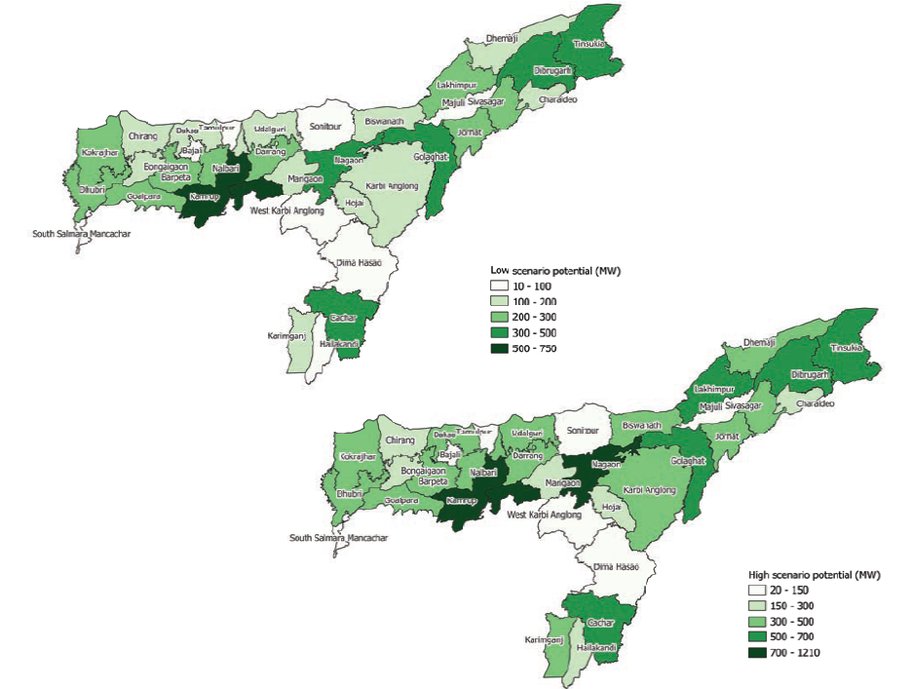
Estimated Theoretical RTS Potential
Estimated RTS potential:
  Low-utilisation scenario: 7,321 MW
  High-utilisation scenario: 13,428 MW
95% of potential lies in residential and mixed-use buildings.
Districts with the highest potential: Kamrup Metropolitan, Kamrup, Nagaon, Tinsukia, Golaghat, followed by Tinsukia, Golaghat, and Dibrugarh,
Solar insolation: 4.01 – 4.61 kWh/m²/day, increasing from north to south.
Source: iFOREST estimates

Slide 9
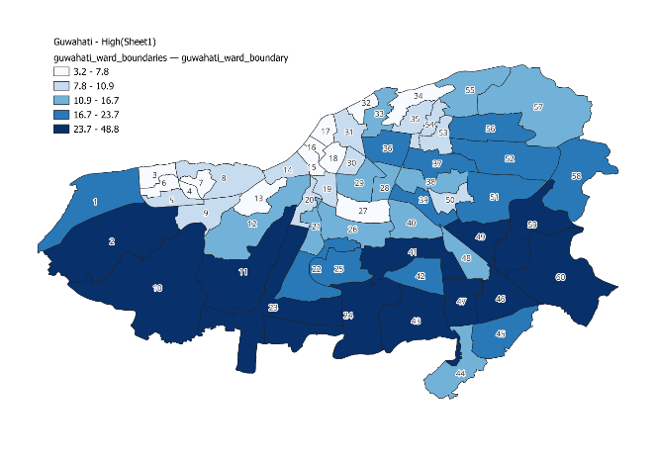
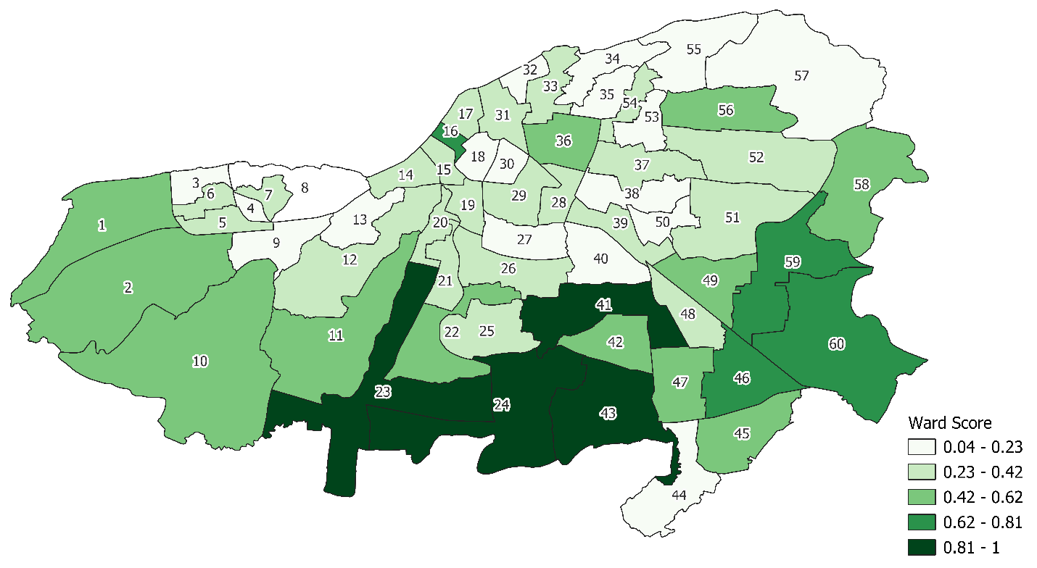
Estimated Theoretical RTS Potential in Guwahati
Variation in RTS potential across Guwahati (high scenario)
Total rooftop area (as measured by BFA) of 33.8 km², and 85% of Guwahati’s BFA is mixed-use buildings.
Guwahati’s RTS potential:
  Low scenario: 626 MW
  High scenario: 985 MW
Priority Wards: Lokhra, Garbhanga, Sarusajai, Bor Soja, has the highest potential (Ward 23), followed by Basistha, Khanapara, Dispur, Kahilipara (Wards 24, 43, 41, 16) have significant potential.
High urban density and flat rooftops (64%) favour solar adoption.
Priority sites for RTS in Guwahati
Source: iFOREST estimates

Slide 10
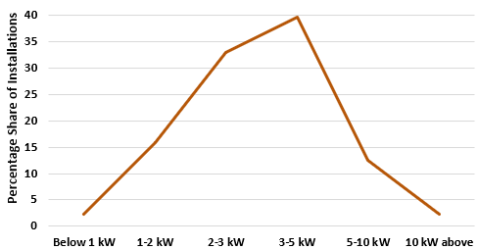
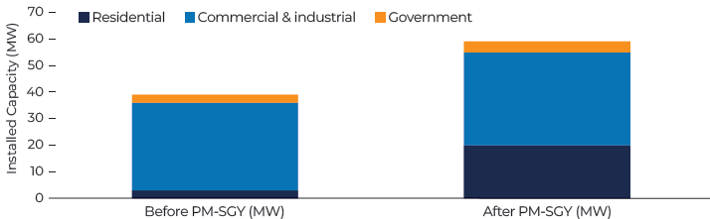
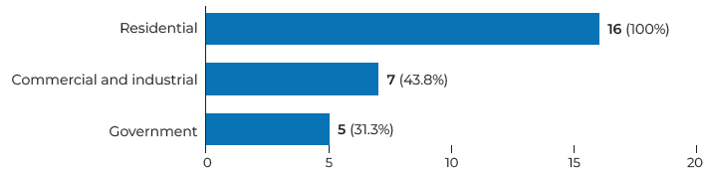
Demand-side assessment
Detailed consultations with 20 EPC vendors, to understand:
Consumer Segment: Initial growth driven by C&I users under GCRTS. Post PM-SGY launch, residential installations surged 6x — now the largest and fastest-growing segment.
System Size: Majority of systems fall in the 3–5 kW range (40%), followed by 2–3 kW (30%), 0–2 kW (20%), and >5 kW (15%).
Business Model: CAPEX dominates (83% of installations); RESCO uptake remains limited but growing.
Geographic Spread: Installations concentrated in high-density areas around Guwahati and Kamrup.
Capacity Building Needs: Survey indicates need for stronger quality assurance and improved RE skilling programs.
Consumer Segments served by EPC vendors in Assam
Size of installed RTS systems in Assam
Growth in various consumer segments of RTS in Assam
Source: iFOREST survey

Slide 11
Barriers to expanding RTS
1. Financial Hurdles
Higher System Costs: RTS in Assam costs ₹70,000 (1 kW) to ₹5.5 lakh (10 kW), significantly higher than ₹45,000–₹60,000/kW in states like Gujarat.
Less Economies of Scale: Per kW cost remains high even for larger systems, increasing the upfront burden on consumers.
Costly Logistics: Logistics cost in Assam is ₹0.8–1/W, compared to ₹0.5–0.7/W in North/West India—driven by distance from vendor locations and poor transport networks.
Higher Manpower Costs: Installation and 5-year maintenance cost ~₹3/W due to limited availability of trained technicians (vs. ₹1/W in other regions).
Post-Subsidy Outlay Still High: Even after subsidies (up to 3 kW), consumers pay between ₹22,000–77,000, which can deter uptake.

Slide 12
Barriers to expanding RTS
2. Supply chain challenges
2. Capacity & Implementation Gaps
Weak transport links delay sourcing of key components (inverters, panels, ACDB/DCDB), increasing costs and project timelines.
High reliance on distant suppliers adds logistics complexity and expenses – 100% DCR mandate (since Aug 2024) & only 4 Indian firms manufacture solar cells.
Vendor Inexperience: Many new PM-SGY vendors lack technical and business skills, affecting quality and service.
Site Mismatch: ~25% of applicants apply without assessing rooftop suitability, leading to rejections and delays.

Slide 13
Recommendations
Target High-Priority Areas and Segments (as identified by rooftop availability)
Barak Valley receives high solar insolation (4.61 kWh/m²/day) but has low RTS uptake.
Guwahati’s highest potential lies in mixed-use buildings and wards like Gorchuk, Betkuchi, Jalukbari, Kahilipara, and Machkhowa.
2. Implement PM-SGY scheme on mission mode:
Adopt micro-level strategies to educate residents about the advantages and procedures, and adopt macro strategies for marketing the scheme to reach a broad audience base
Branding through the highest office, with a dedicated local name
District-level launches and felicitating solar champions (in identified the high-potential zones)
Significant mismatch between PM-SGY applicants and actual installations. Leverage digital tools for communicating with & facilitating consumers; application and installation tracking; scheme & asset monitoring, engaging with vendors & overall communications.

Slide 14
Recommendations
3. Strengthening Local Manufacturing and Supply Chain
Assam targets 3 GW solar PV cell production by 2030 under ICEP — ambitious given zero current manufacturing. Local PV manufacturing could cut installation costs by 10–15% and meet DCR.
Estimated 30,000+ green jobs can support a just and inclusive energy transition.
4. Policy & Regulatory Strengthening
AERC’s draft for group and virtual net-metering can enable demand aggregation and optimises land use.
RESCO model can benefit C&I and government buildings; needs incentive structures. A state-backed scheme with payment security funds can attract significant investments.
Mandate RTS for all new government, C&I buildings; explore energy storage with capital subsidy.
5. Support for New Business Models
Low-income residential segment is underserved despite subsidies. APDCL’s Utility-led CAPEX Model (UBBM) can scale residential RTS — learn from Kerala’s SAURA scheme (200 MW in 5 years).
For govt. & C&I consumers, support can be extended through one-time project incentives, low-cost credit lines, capital subsidies for RTS + BESS, and robust payment security mechanisms.

Slide 15

Way Forward: Phased Roadmap for RTS Implementation
Short-term
(1–2 years)
Medium-term
(3–5 years)
Long-term
(5+ years)
Set up a dedicated RTS cell within APDCL to drive adoption.
Focus on high-potential regions to reach out to consumers. Create solar champions.
Update policies/regulations to reflect sector needs.
Pilot new business models for C&I, residential, and government consumers.
Expand financial incentives based on demand trends.
Strengthen net metering and enabling policies for C&I and group housing.
Build capacity of local professionals and vendors through targeted programs.
Improve logistics via public-private partnerships to reduce solar deployment costs.
Align RTS targets with the State’s ICE Policy.
Establish local PV manufacturing to cut costs and boost jobs.
Integrate RTS data with smart grid tools (e.g., SCADA) for better planning.
Promote adoption of advanced technologies and innovative business models.

Slide 16

Thank You

Slide 17
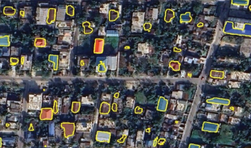
Methodology to evaluate RTS potential for Assam
The dataset for constructions in Assam was generated using machine learning (ML).
Step 1: High-resolution data
extracted from ESRI and
Google
Step 2: Building Outlines classified using Machine Learning
Step 3: Rooftops categorized into sloped or flat using machine learning
Step 4: GHI was overlaid on the state map to reveal regional variations in solar insolation.
The following categories of buildings were considered in the classification algorithm
  Residential
  Commercial
  Industrial
  Mixed
  Education
  Other- Health, Government, Transport, Other Public institutions
Along with BFA and rooftop utilization, the study assumes an installation factor of 0.1 kW per square meter of rooftop area.

Slide 18
Methodology to identify priority wards in Guwahati
The following approach was followed:
Step 1: Generating city-level BFA data (60 wards)
Step 2: Calculating the linear rate of increase in residential BFA for each ward between 2011 & 2024
Step 3: Estimating the 2024 population using the census projection guidelines
Step 4: Distributing
additional population in each ward based on the linear growth rate of residential BFA
The following factors were considered for selecting priority wards:
Priority Factor | Factor Name | Relation with score | Weight factor
1 | Solar Rooftop Potential | Direct | 50%
2 | Population Density | Direct | 40%
3 | Tree Cover Density | Inverse | (-) 10%
To rank the wards, ward values under 3 factors were converted into scores 0-1 (1 being maximum, 0 being minimum)
The Final score of each ward is calculated based on the normalised weighted average of all three factors:

