Slide 1
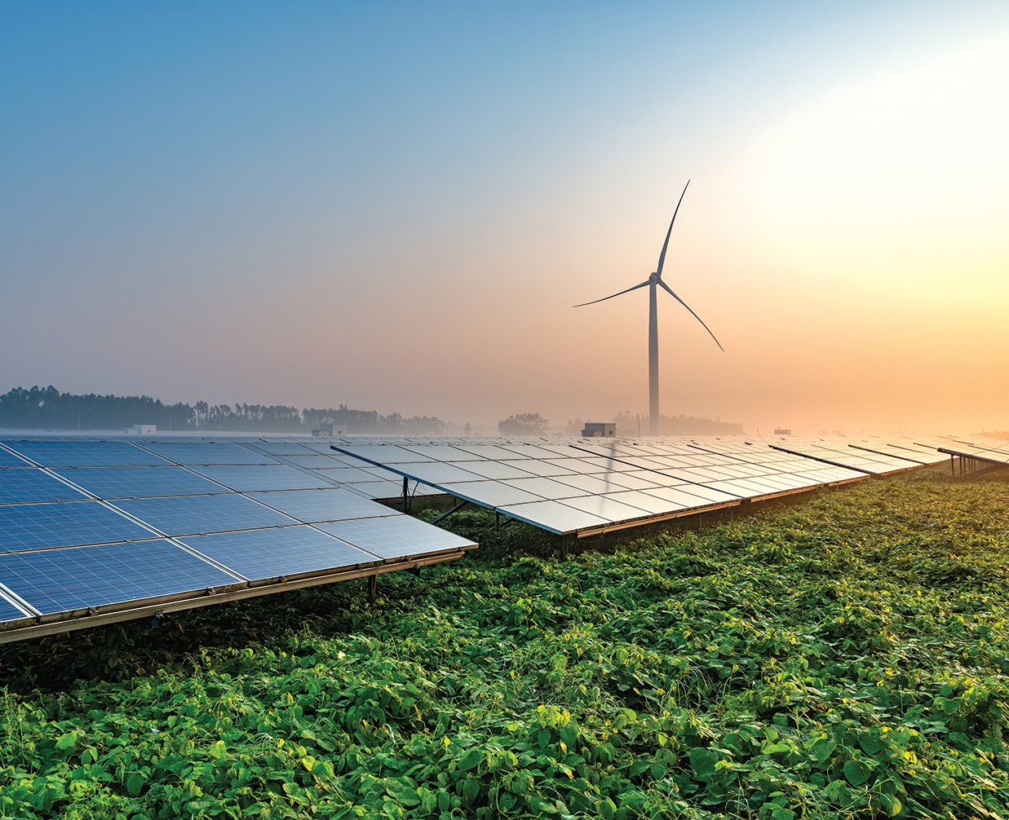

Odisha Renewable Energy Potential Reassessment

Slide 2
Solar Energy

Slide 3

Average Solar Insolation Across Key States
Over 300 sunny days; average solar radiation of 5.5 kWh per sq m
Peak insolation is about 900 W per sq m, comparable to states like Gujarat and Uttar Pradesh
Average insolation of about 390 W per sq m, comparable to Karnataka
Monthly and hourly insolation across major states
Source: NASA LaRC, iFOREST Assessment

Slide 4
Wasteland Availability in Odisha
16% of the land area of 155,710 sq km includes wasteland of 18 sub-categories
18,422 sq km
Source: Wasteland Atlas, 2019, Department of Land Resources, GoI

Slide 5
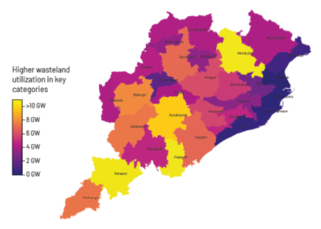
Broad-based Assessment
Considering high utilization of 50%-10% in key wasteland categories, with lower ecological significance, leads to solar potential of 149 MW across 2,973 sq km of land.
68% of the potential is in 13 southern and eastern districts
Angul, Bolangir, Keonjhar, Koraput and Malkangiri are key due to higher concentration of large land patches with lower socio-ecological conflict and higher insolation
155,710 square kilometres (sq km)

Slide 6
Utilizing Agriculture Land
Agricultural land frequently utilised for solar - about 68% of existing projects in India.
Nearly three-fourths of the agricultural land in Odisha is mono-cropped, which can be utilized through agro-PV implementation.
5% utilisation of mono-copped agricultural land can support 8.14 GW of solar capacity.
Cropping patter on agricultural lands in Odisha (hectare)
 | Cropped once | Cropped twice | Cropped more than twice | Total (net)
Irrigated area | 575,724 | 664,413 | 46,508 | 1,286,645
Unirrigated area | 2,681,201 | 220,483 | - | 2,901,684
Total | 3,256,925 | 884,896 | 46,508 | 4,188,329

Slide 7
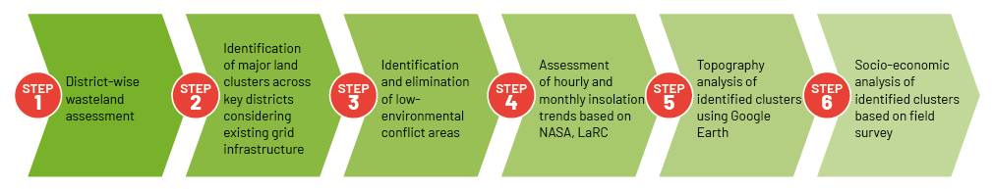
Large Wasteland Clusters for Solar
Methodology
Data/Parameter | Source/Tool
District-wise wasteland LULC Data, 2015-16 | Wasteland Atlas, 2019 by Department of Land Resources, GoI
Low-environmental conflict zone mapping | Site Right Tool of The Nature Conservancy
Transmission network availability mapping | DARPAN portal by CSTEP
Solar insolation | NASA’s LaRC portal
Topography mapping | Google Earth

Slide 8
Large Wasteland Clusters for Solar
13 clusters identified across 9 districts, comprising 160 small sites aggregating 460 sq km of area and an aggregate potential of 23 GW,
District-wise identified clusters
Capacity-wise analysis of potential sites across clusters
District | No. of clusters | Potential (GW)
Angul | 3 | 5.3
Balangir | 2 | 4.5
Jharsaguda | 2 | 1.8
Keonjhar | 1 | 5.2
Koraput | 1 | 3.3
Malkangiri | 1 | 1
Mayurbhanj | 1 | 0.7
Nabarangpur | 1 | 1.3
Sundargarh | 1 | 3
Project Size (MW) | No. of sites | Area (Sq km) | Potential (MW)
15 - 50 | 80 | 51.87 | 2,615.27
50 -100 | 26 | 39.6 | 1,994.82
100 - 150 | 14 | 35.17 | 1,775.12
150 - 200 | 13 | 44.32 | 2,235.38
200 - 250 | 3 | 13.28 | 671.12
250 - 300 | 8 | 44.36 | 2,224.14
300 - 350 | 3 | 18.7 | 941.26
350 - 400 | 2 | 13.97 | 711.02
400 - 450 | 4 | 33.99 | 1,676.91
>450 | 7 | 164.39 | 8,244.02
Total | 160 | 459.65 | 23,089.06
Source: iFOREST Assessment

Slide 9
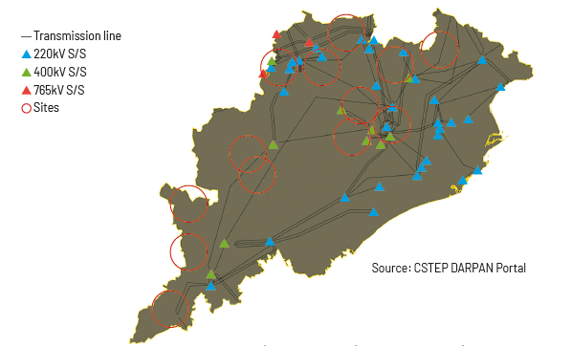
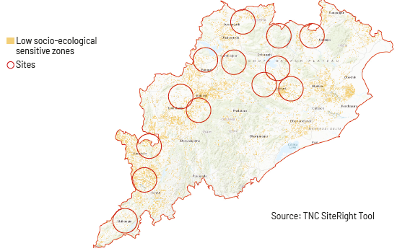
Cluster-wise calculated LCoE
Identified clusters against existing transmission infrastructure
Cluster | Peak insolation (W per sq km) | Average insolation
Angul Cluster 1 | 954 | 400
Angul Cluster 2 | 958 | 386
Angul Cluster 3 | 950 | 411
Bolangir Cluster 1 | 937 | 408
Bolangir Cluster 2 | 940 | 421
Jharsaguda Cluster 1 | 972 | 415
Jharsaguda Cluster 2 | 972 | 415
Keonjhar Cluster 1 | 1,037 | 397
Koraput Cluster 1 | 1,004 | 441
Malkangiri Cluster 1 | 952 | 409
Mayurbhanj Cluster 1 | 902 | 367
Nabrangpur Cluster 1 | 991 | 407
Sundargarh Cluster 1 | 969 | 419
Identified clusters against low socio-ecological sensitive zones
Survey evaluating basic requirements of land condition, land ownership, current land use, water availability, grid availability, transport availability etc., revealed most sites to be feasible for development
Source: iFOREST Assessment

Slide 10
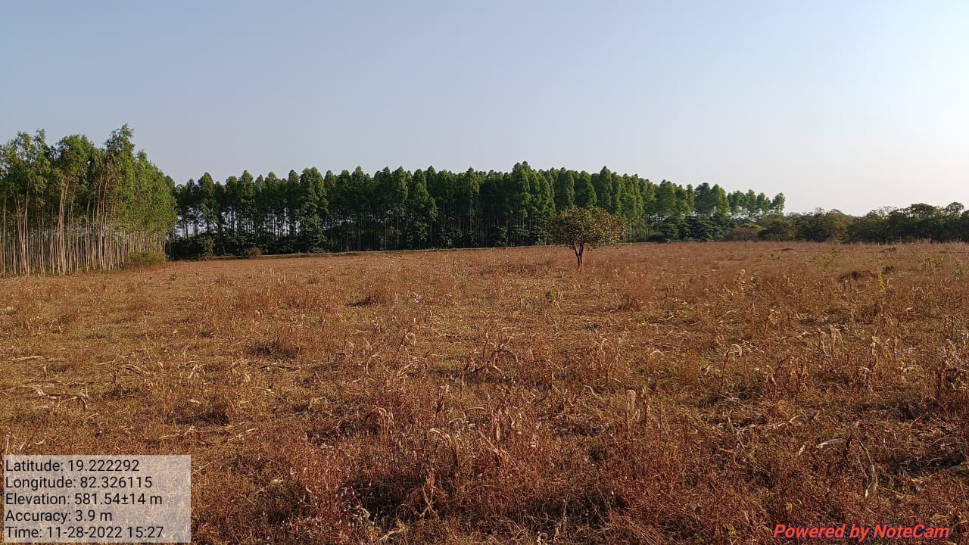
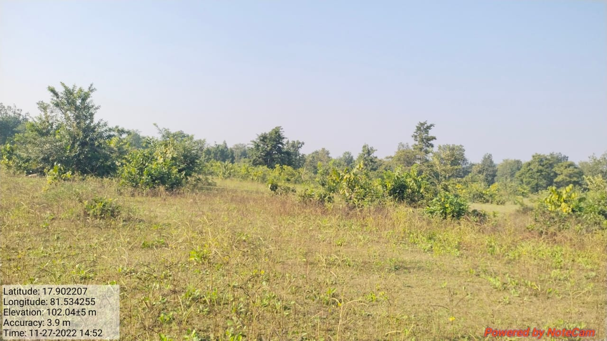
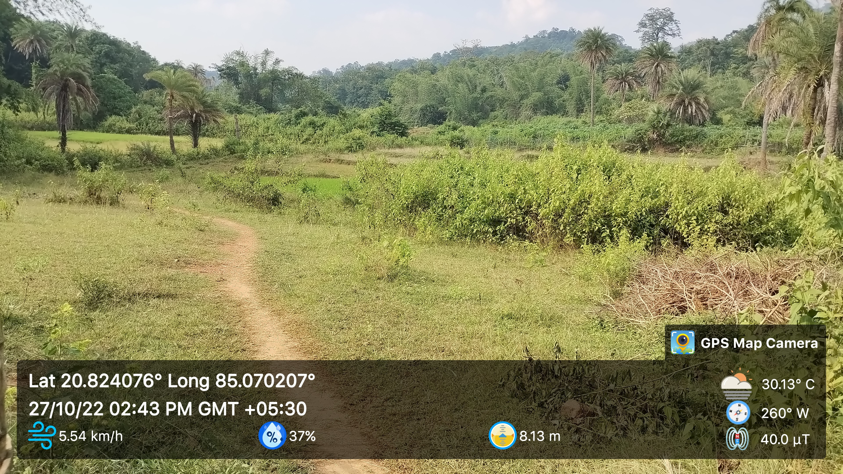
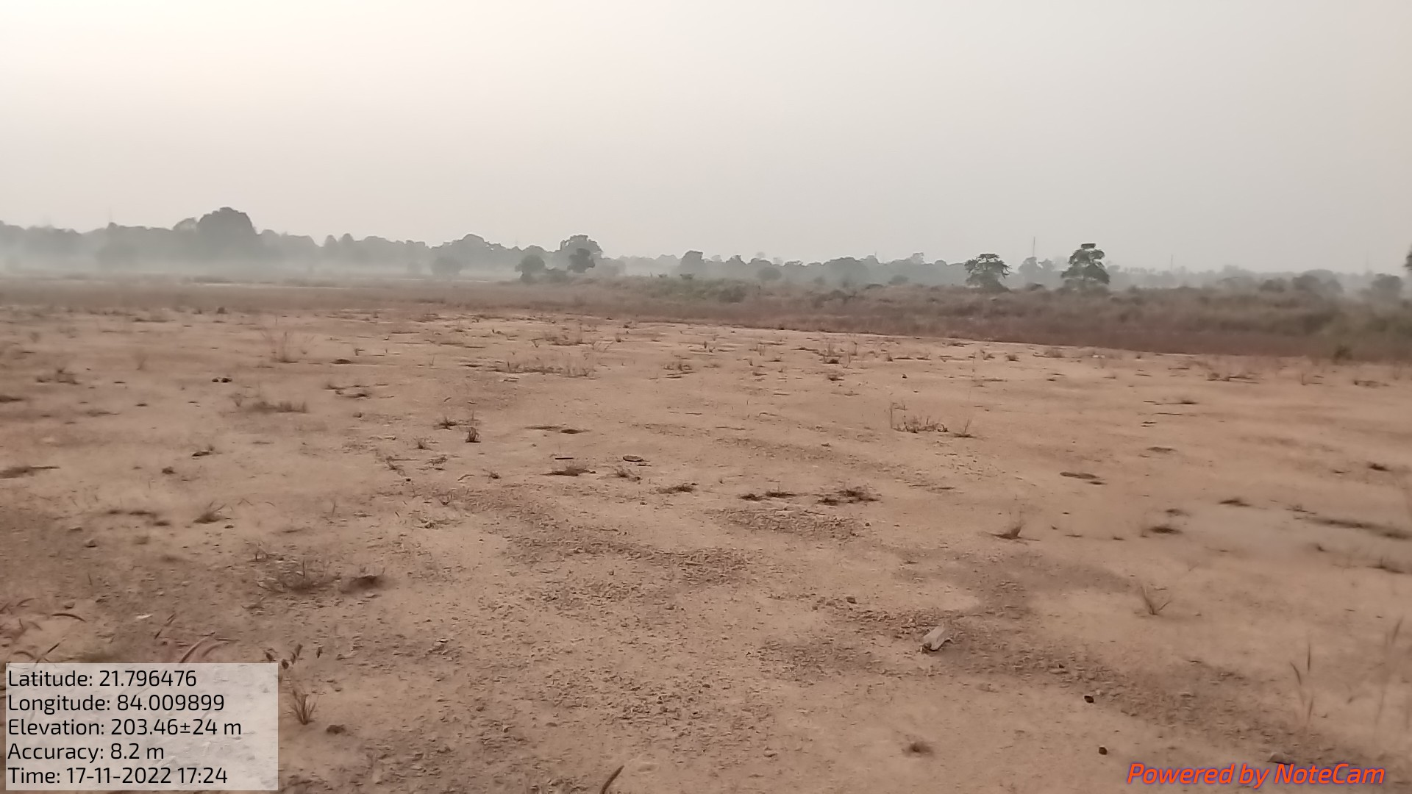

Slide 11
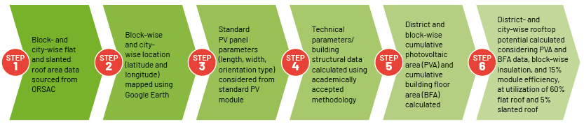
Rooftop Solar Potential Assessment
Methodology
Data | Source/Tools
Flat and slanted roof data | ORSAC
Building structural data calculation | Rhythm Singh, Approximate rooftop solar PV potential of Indian cities for high-level renewable power scenario planning, Sustainable Energy Technologies and Assessments, Volume 42, 2020, 100850, ISSN 2213-1388
Standard module considered for installation | Tata Power Solar TP300 export series
Solar technical parameters calculations | Google earth, University of Oregon solar radiation monitoring lab and NASA LaRC

Slide 12
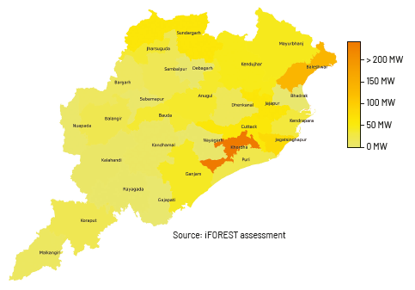
Rooftop Solar Potential Reassessment
Solar rooftop potential estimated to be 1,133 MW at a utilization. Khordha district accounts for the highest potential, followed by Baleswar and Jagatsinghpur.
Source: ORSAC; iFOREST Assessment

Slide 13
Blocks with highest assessed solar rooftop potential
Urban block of Bhubaneshwar has the highest assessed potential, followed by other urban blocks of Baleshwar and Jatani and the industrial blocks of Kujanga, Kuanrmunda, and Jharsuguda.
Cities with highest assessed rooftop potential
Source: iFOREST Assessment

Slide 14
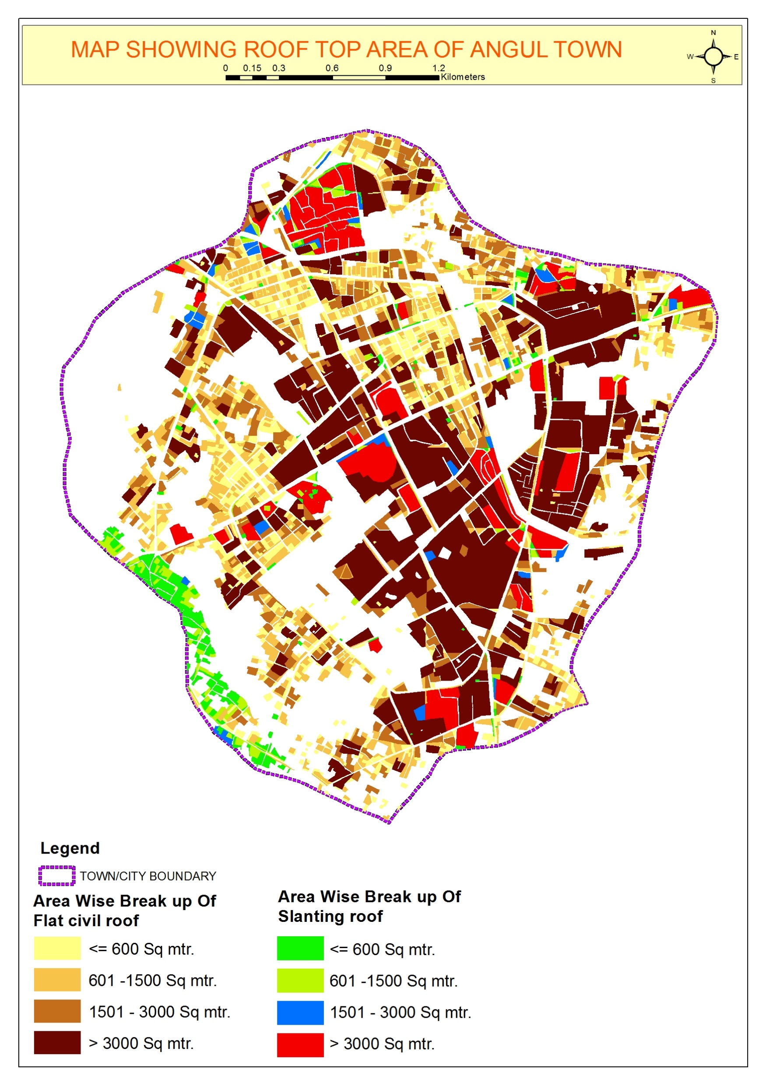
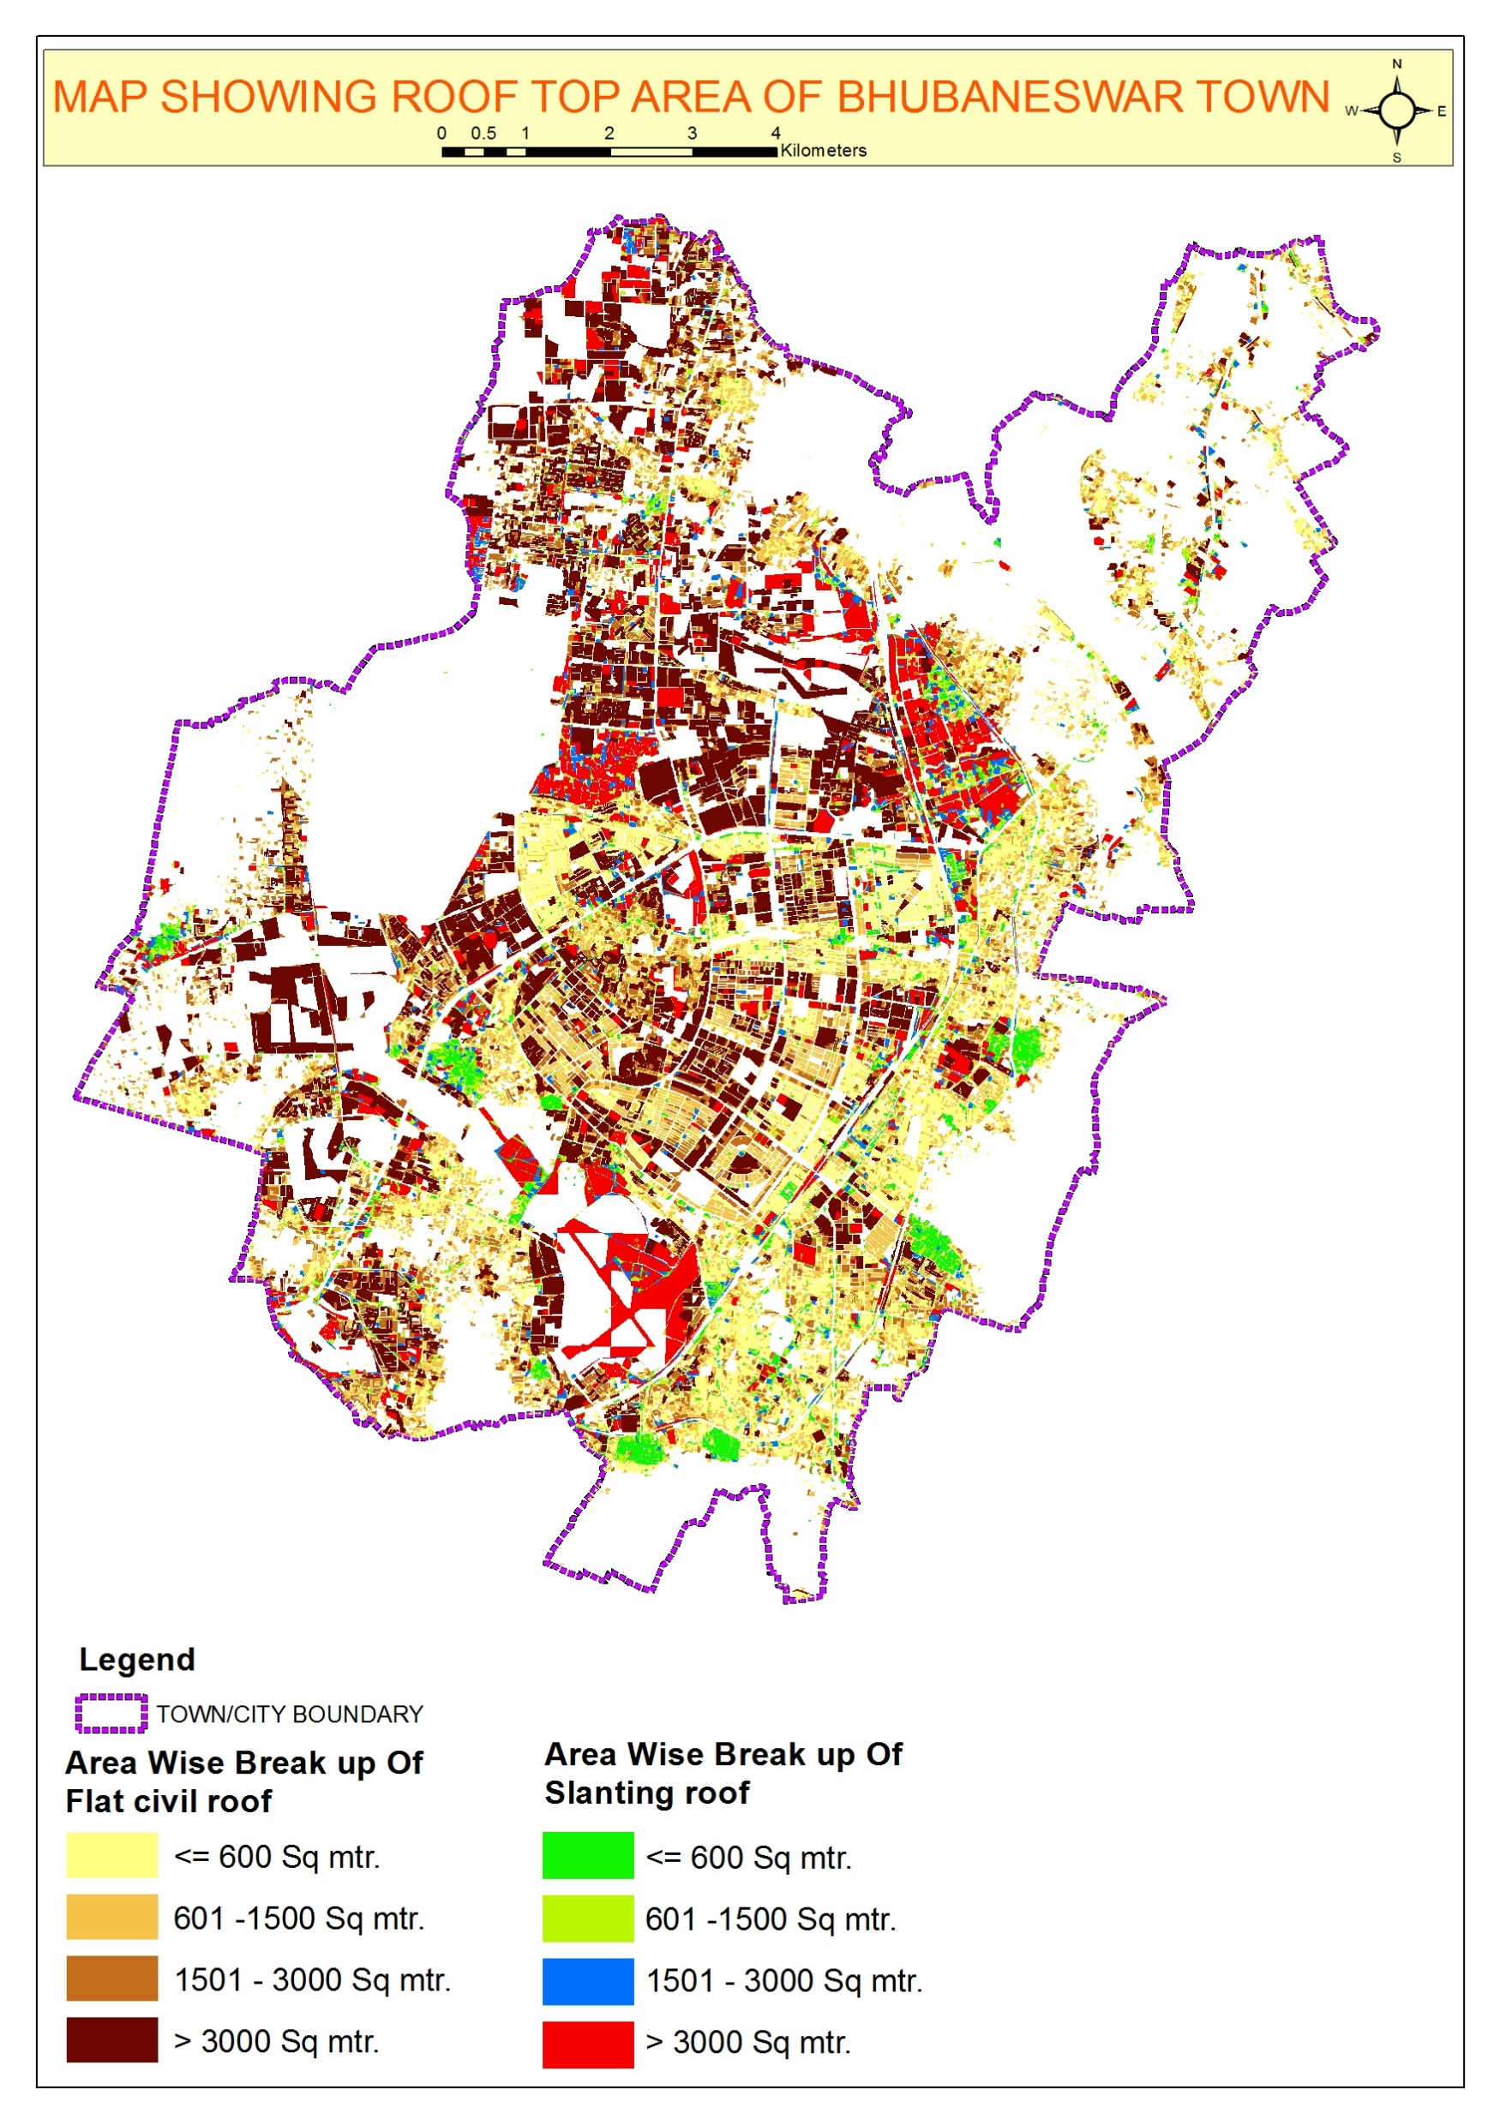
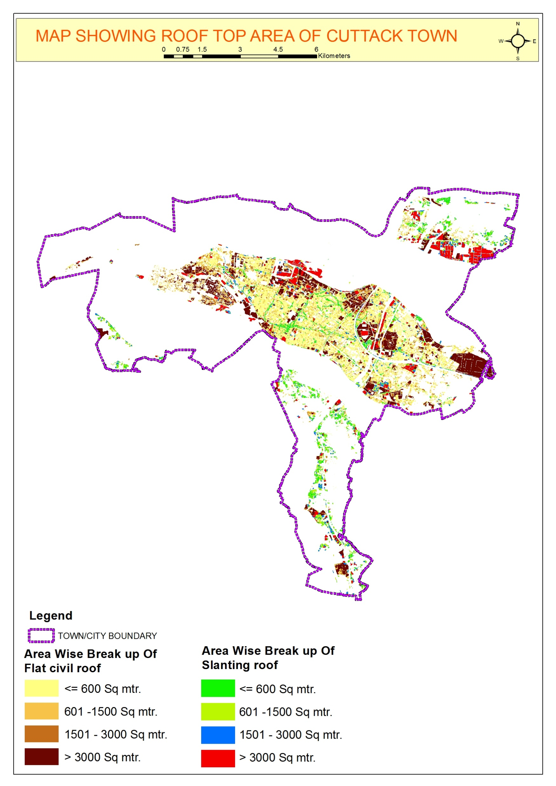
Rooftop GIS maps
Source: ORSAC

Slide 15
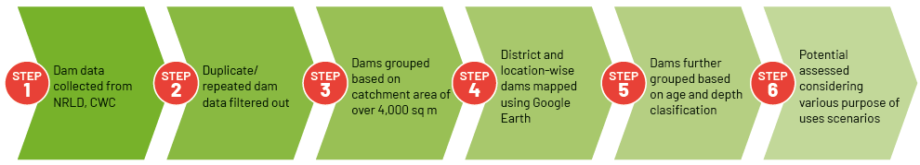
Floating Solar Potential Assessment
Methodology
Data/Parameter | Source/Tool
Reservoir data, 2019 | CWC, NRLD
Reservoir mapping | Google earth
Water occurrence, spread area and water level | IWRIS, ISRO Bhuvan WBIS

Slide 16
Floating Solar Potential Assessment
Area utilization scenarios for assessment of floating solar potential (% of area)
Considering conservatives estimates of dam area utilization, 125 dams in Odisha can support 6 GW of floating solar capacity under a low utilization scenario and up to 25.9 GW under high utilization scenario
Reservoir purpose | Scenario - I | Scenario - II | Scenario - III
Irrigation and water supply | 5 | 10 | 20
Irrigation | 10 | 25 | 50
Flood control, hydroelectric, Irrigation and water supply | 1 | 2 | 2
Hydroelectric | 3 | 5 | 10
Water supply | 10 | 25 | 50
Irrigation, flood control | 5 | 10 | 10
Irrigation, hydroelectric, navigation | 2 | 5 | 10
Irrigation, hydroelectric | 2 | 10 | 10
Irrigation, hydroelectric, water supply | 2 | 5 | 5
Irrigation, pisciculture | 5 | 10 | 20
Irrigation, pisciculture, water supply | 5 | 10 | 20
Category-wise number of operational dams in Odisha
 | Young (0 to 20 years) | Middle (20 to 50 years) | Old (50 to 100 years) | Very old (>100 years) | Total
Very low depth (3 to 10 m) | 0 | 0 | 0 | 0 | 0
Low depth (10 to 15 m) | 2 | 51 | 5 | 0 | 58
Medium depth (15 to 30 m) | 4 | 96 | 7 | 3 | 110
High depth (30 to 100 m) | 1 | 13 | 4 | 0 | 18
Very high | 0 | 0 | 0 | 0 | 0
Total | 7 | 160 | 16 | 3 | 186

Slide 17
Floating Solar Potential Assessment
Leading districts for floating solar installation
Leading reservoir sites for floating solar installation
Given the assumption, over 1 GW capacity can be accommodated at reservoirs like Rengali, Tikilipada, Upper Indravati, Nabrangpur, Jalaput and Hirakund.

Slide 18
Floating Solar Potential Assessment
Monthly water spread area trends at leading dams over last decade
Water spread analysis of major reservoirs indicates much higher potential for solar panel installations
For instance, water spread area for the 378.4 sq. km Rengali reservoir for the last 10 years has been lowest in the month of July ranging between 195 sq km to 140 sq km. Potentially 7 to 10 GW can be set up on the reservoir, at 50-70% of lowest spread area.

Slide 19
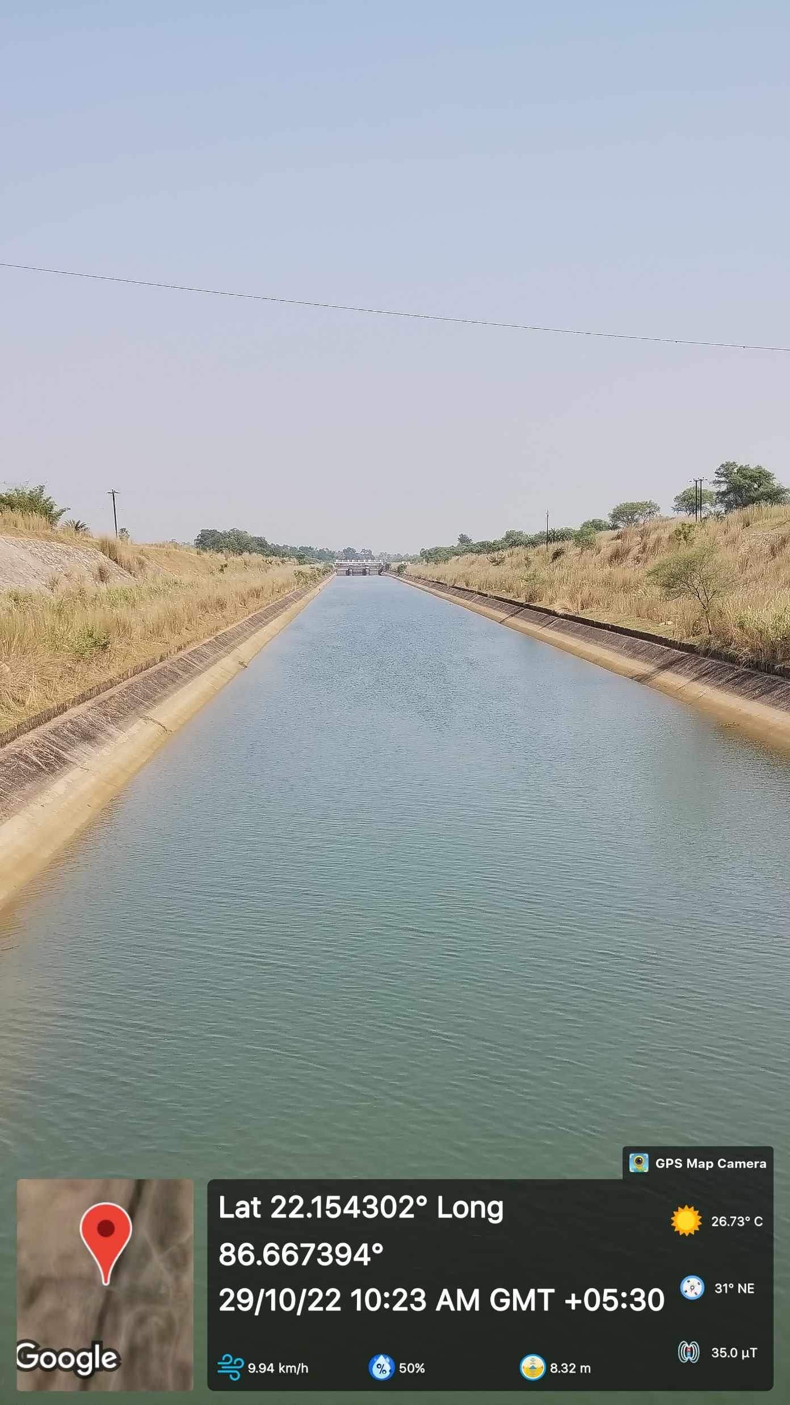
Canal Top Solar Potential Assessment
410 km of existing concrete-lined irrigation projects can accommodate canal top solar of up to 256 MW.
Canal project name | Target length (km) | Achieved length (km)
Talasara Medium Irrigation Project | 43.71 | 43.72
Sarafgarh Medium Irrigation Project | 33.45 | 33.45
Pitamahal Medium Irrigation Projects | 24.11 | 24.12
Gompakunda Main Canal of Potteru Major Irrigation Project | 16.68 | 16.58
Tamasa Main Canal and Udayagiri distributary of Potteru Major Irrigation Project | 21.44 | 21.51
Parjang Branch Canal of Rengali Major Irrigation Project | 142.05 | 115.74
Right Main Canal of Upper Indravati Major Irrigation Project | 83.71 | -
Astaranga minor of Mahanadi Delta-II Major Irrigation System | 1.95 | 1.95
Kendrapada Main Canal of Mahanadi Delta-I Major Irrigation System | 28.75 | 28.70
Jajpur Main Canal and its system of Baitarani Major Irrigation system | 40.93 | 36.06
Kanas Branch Canal of Mahanadi Delta-II Major Irrigation system | 40.44 | 40.44
Anandapur Main Canal and its system of Salandi Major Irrigation Projects | 57.50 | 47.64
Total | 534.72 | 409.91
Source: Dept. of water resources, Odisha

Slide 20
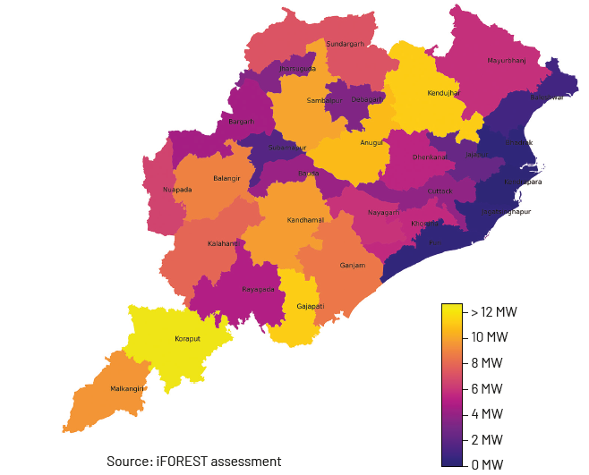
Aggregate Assessed Solar Potential
Category | Potential (GW)
Ground-mounted | 148.6
Floating | 25.9
Rooftop | 1.1
Canal | 0.2
Total | 175.8
Koraput district leads solar potential with 7% share, followed by 6% each in Gajapati, Keonjhar, Angul, Sambalpur, Kandhamal, and 5% in Malkangiri, Balangir, Ganjam, Kalahandi.
Source: iFOREST Assessment

Slide 21
Wind Energy

Slide 22
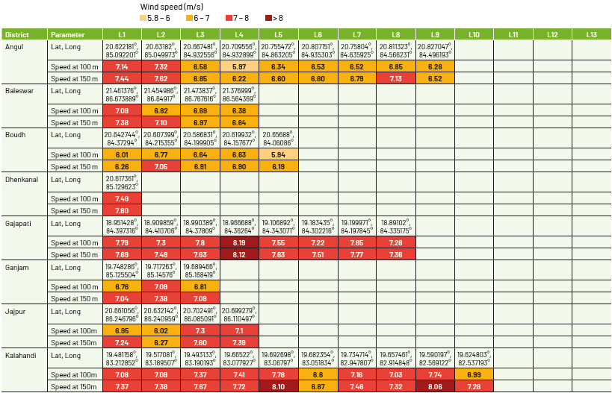
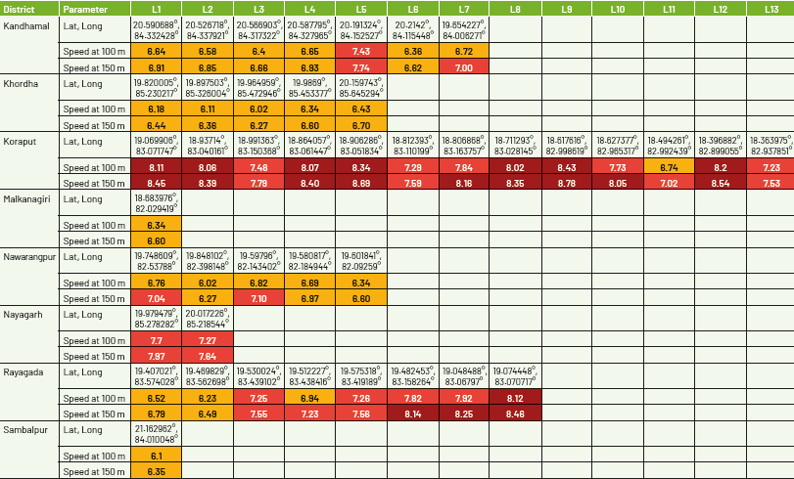
Wind Potential Sites Identification
Global Wind Atlas (GWA 3.1) utilized to assess wind resources and Google Earth to understand land features.
86 locations identified with average wind speed ranging from 6.2 m/s to 8.8 m/s at 150m hub height across 16 districts.
Nearly 65% of identified locations are in Koraput, Kalahandi, Angul, Rayagada, Gajapati and Kandhamal.

Slide 23
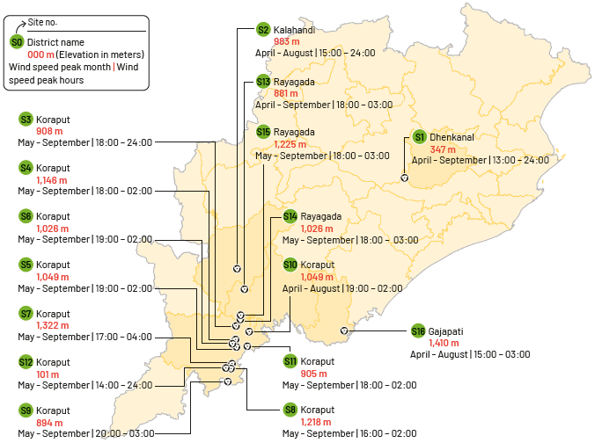
Detailed Assessment of Key Wind Sites
16 key sites assessed with wind speed of 7.6-8.6 m/s at 150m hub height, which can generate CUF of 22% to 29%.
Mostly sited on hilly terrains with average elevation of 968m, and highest elevation of 1,410m.
Peak wind speed months are April to September (aliging with peak demand months of July to September)
Peak wind speed hours typically starts in the evening till after midnight (aligning with evening peak from 1800 Hr to 2100 Hr)

Slide 24
Biomass

Slide 25
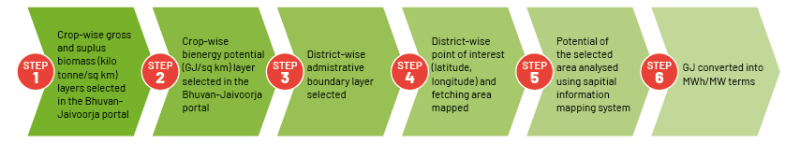
Biomass Potential Reassessment
Productivity and heating value for crop residue-based bioenergy production
Crops | Yield/Productivity (kg/ha) | Dryness factor (%) | Residue type | Heating value (MJ/kg)
Rice | 2,730 | 0.86 | Straw | 15.54
 |  |  | Husk | 15.54
Wheat/Maize/Ragi | 3,195 | 0.86 | Straw | 17.15
 |  |  | Husk | 17.39
Cotton | 547 | 0.80 | Stalk | 17.4
 |  |  | Husk | 16.7
 |  |  | Boll shell | 18.3
Sugarcane | 72,268 | 0.83 | Bagasse | 20
 |  |  | Top and leaves | 20

Slide 26
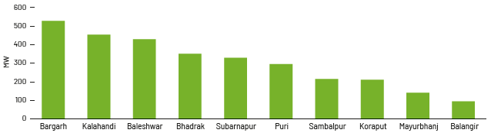
District-wise Assessed Biomass Potential
District-wise and crop-wise yearly surplus biomass generation
Cumulative biomass potential assessed to be around 3.4 GW, largely dependent on rabi rice crop (75%- 90% of the gross and surplus biomass potential)
Bargarh district leads with 16% share in surplus biomass generated, followed by Kalahandi and Baleswar with 12-13%
Top 10 district-wise biomass potential

Slide 27
Thank You.

